Slide 1


INTERNSHIP 5.0 - BATCH 1
EDU CONSULTANCY SYSTEM
Revolutionizing Educational Planning and Guidance
TEAM 3
Arya Lakshmi M
Pamula Indhu Sri
Ramkumar Arcot Dharmalingam
Kamlesh Choudhary
Taresh
Sanjeev G
MENTOR -

Slide 2

PROJECT OVERVIEW
Guidance to students for educational planning, training, and product sales.
Key Outcomes:
Centralized platform for educational planning.
Access to curated content and learning resources.
Secure data and payment management.

Slide 3

FEATURES AND BENEFITS
FEATURES:
User-friendly login and registration.
Dashboard views for admin, student, and parent.
Appointment scheduling and status tracking.
Subscription and payment management.
Notifications and feedback system.
BENEFITS:
Simplified educational guidance.
Seamless communication.
Organized payment and subscription handling.

Slide 4
MODULES IMPLEMENTED
USER AUTHENTICATION AND REGISTRATION
PRODUCTS AND BLOGS
Secure registration and login system with role-based access for admin, students, and parents.
Displays educational products and blogs with seamless browsing and selection.
PAYMENT
ADMIN DASHBOARD
Integrated payment gateway supporting various methods with subscription tracking.
Role-specific tools for managing users, payments, subscriptions, and feedback efficiently.

Slide 5
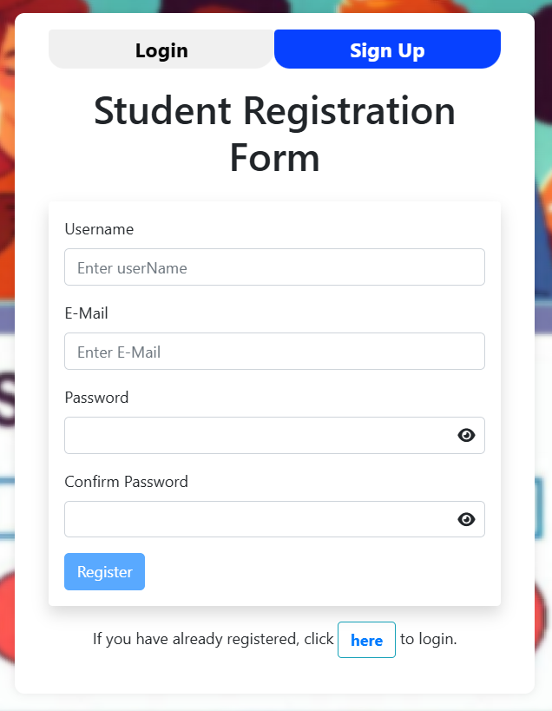
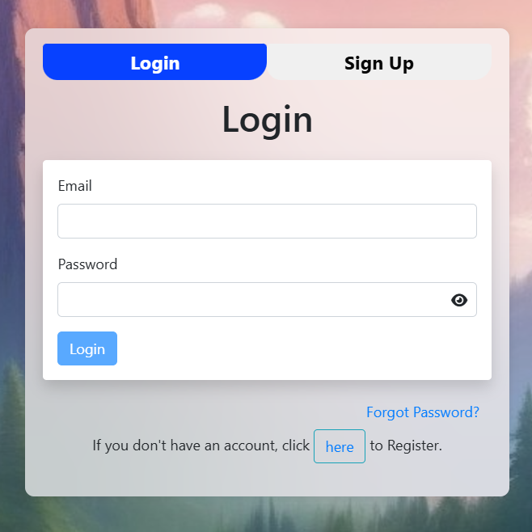

MILESTONE 1 – USER AUTHENTICATION
CONTENT
Implemented user registration and login.
Spring Security for role-based dashboards.
FEATURES
Email verification.

Slide 6
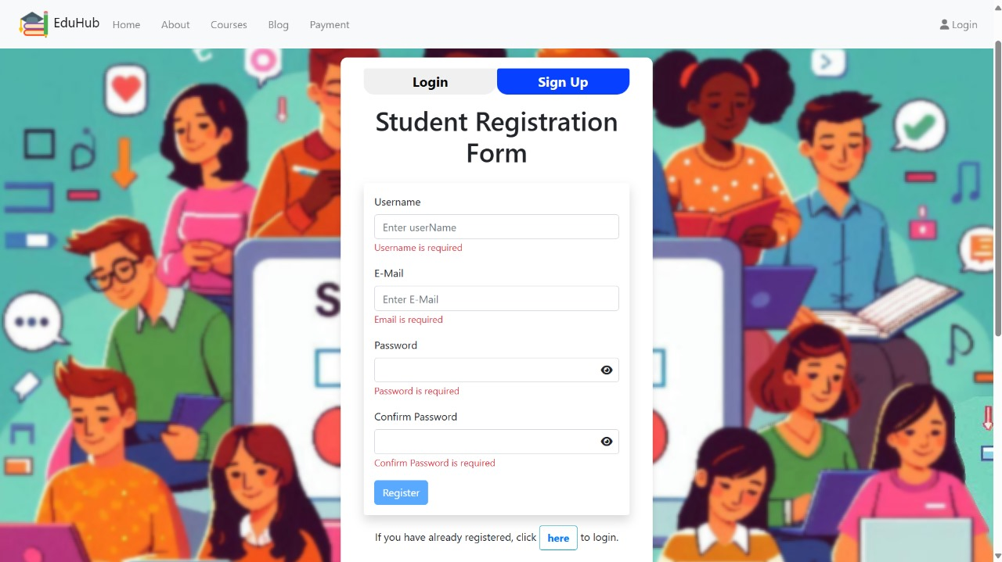

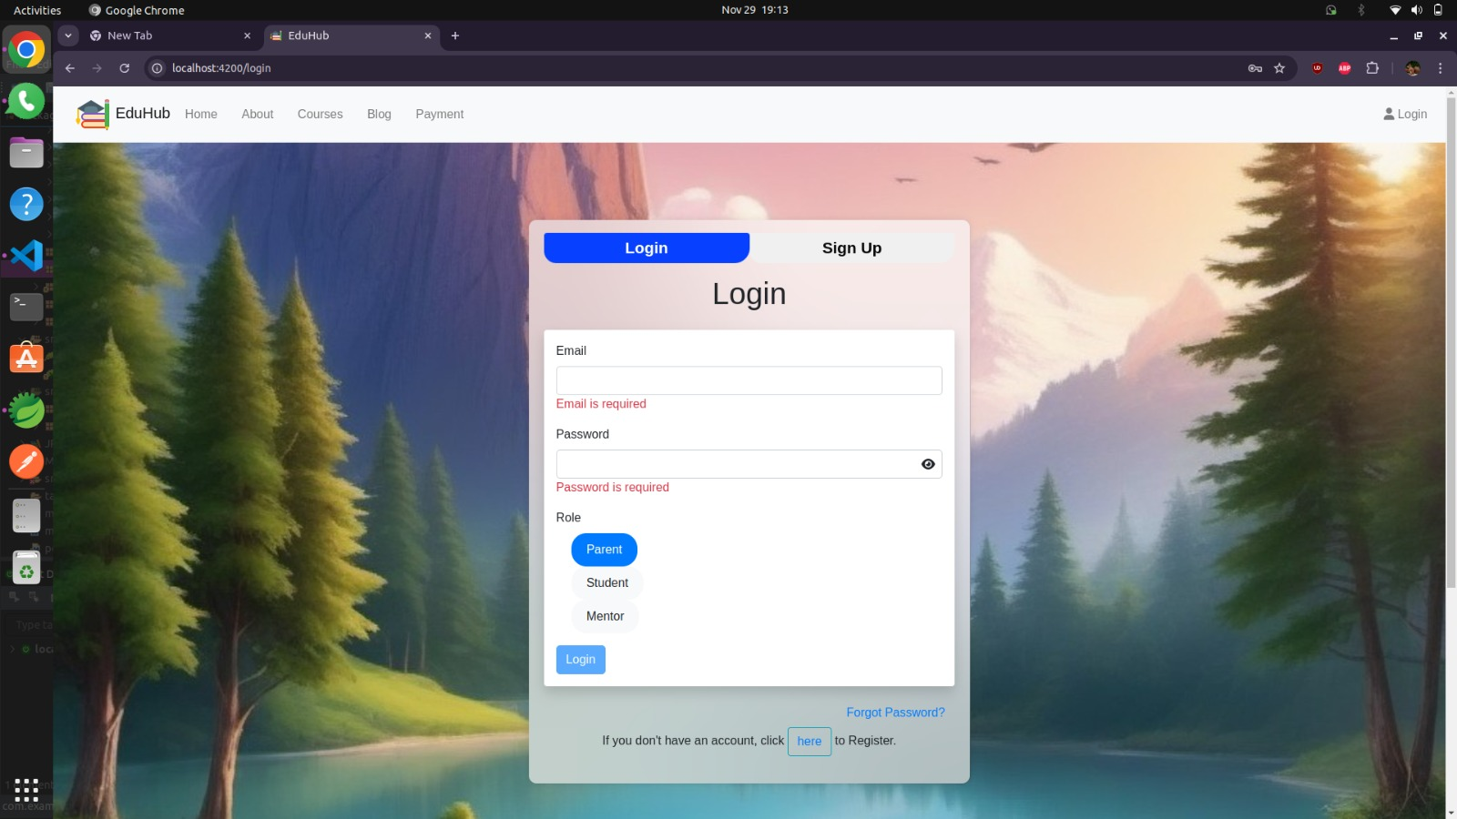
Form Validations

Slide 7
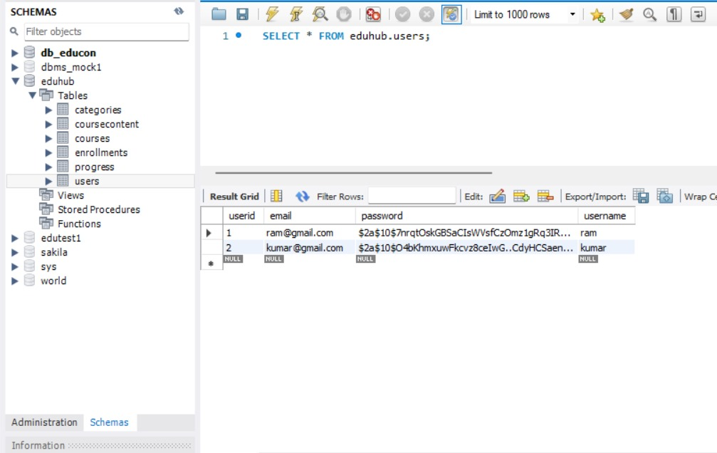
The displayed data represents the user information stored in the users table of the eduhub database. This table is part of the db_educon schema.
The data reflects user credentials collected during the registration process on the platform.

Slide 8
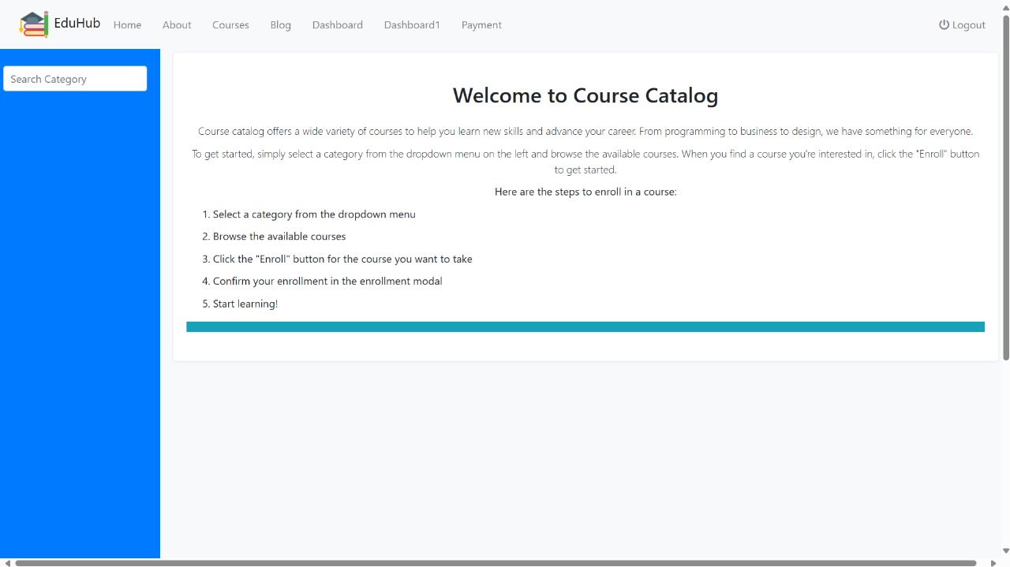
MILESTONE 2 – COURSE AND BLOG INTERFACE

Slide 9
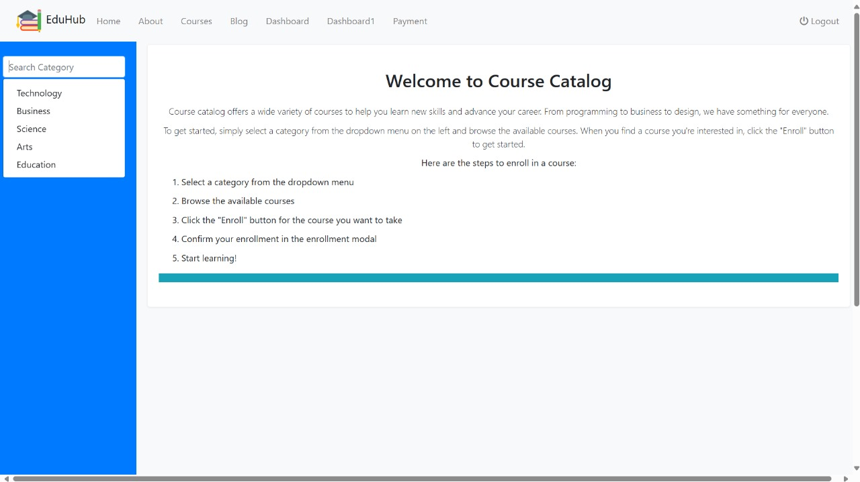
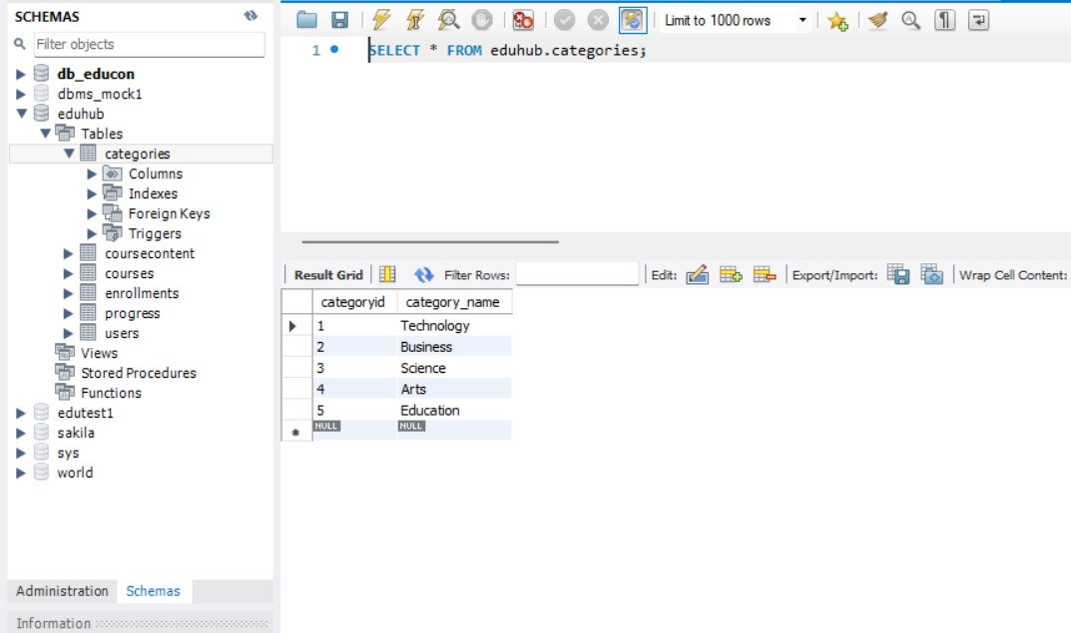
Course selection by selecting a category, the categories are added through database.

Slide 10
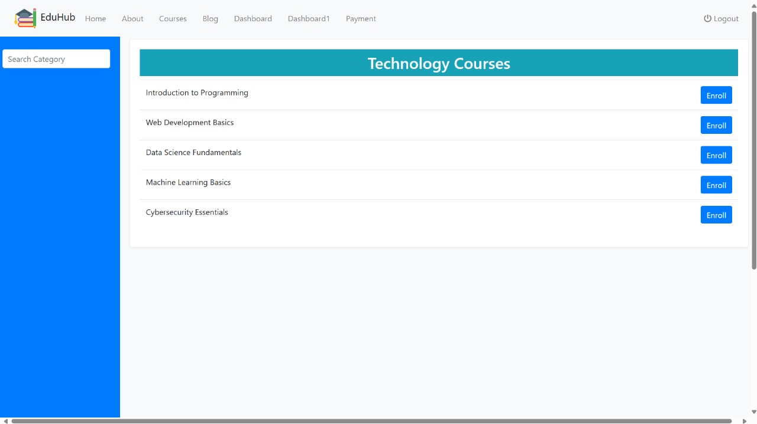
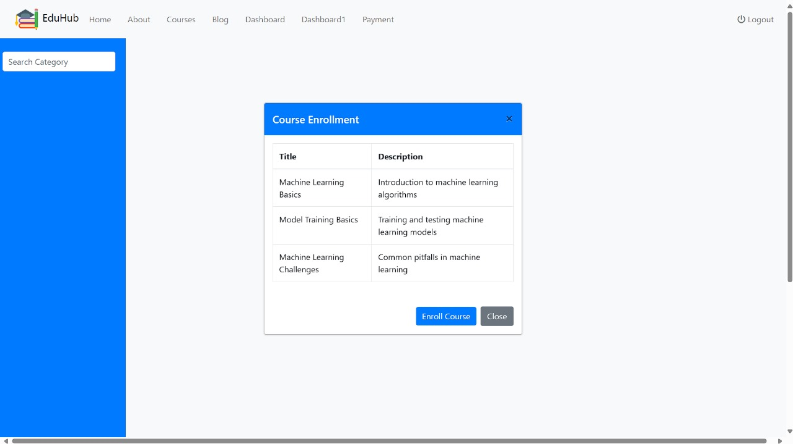
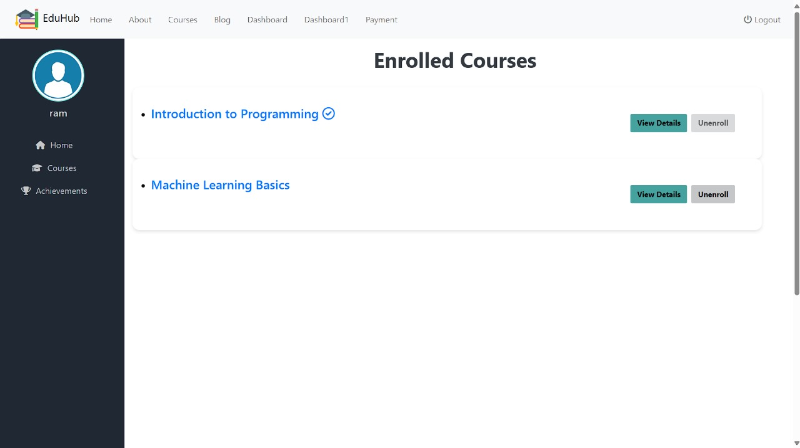

Slide 11
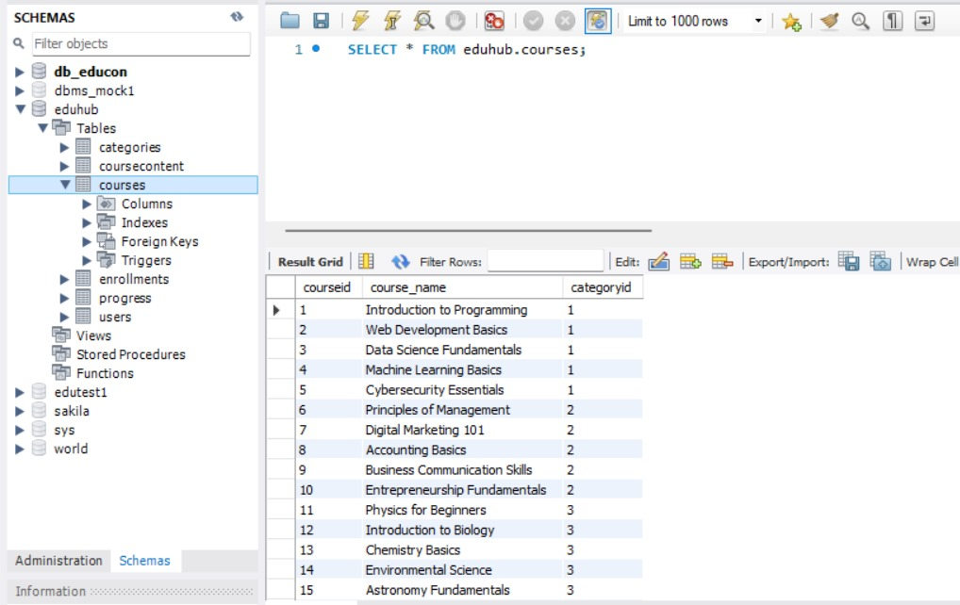

Slide 12
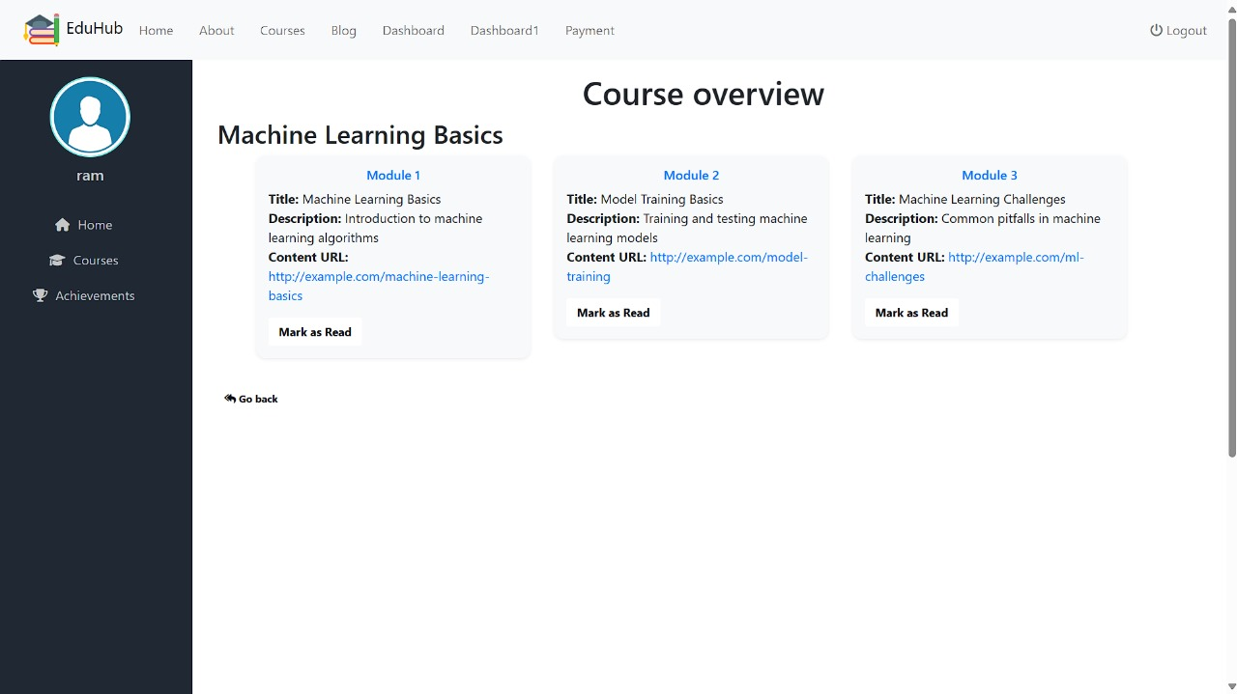
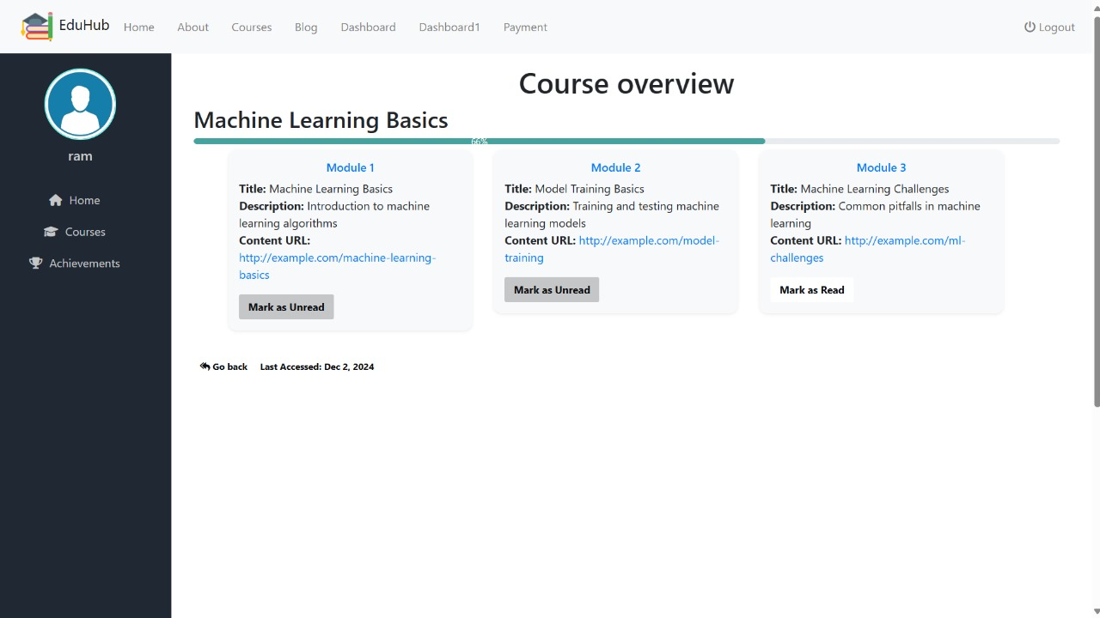
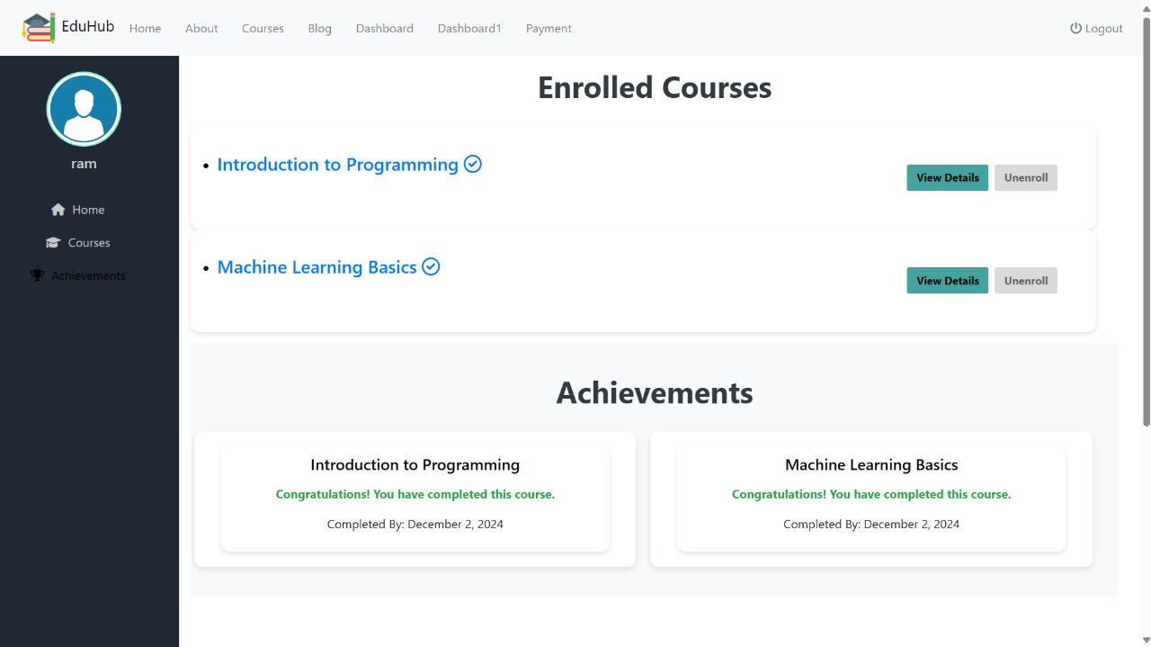

Slide 13
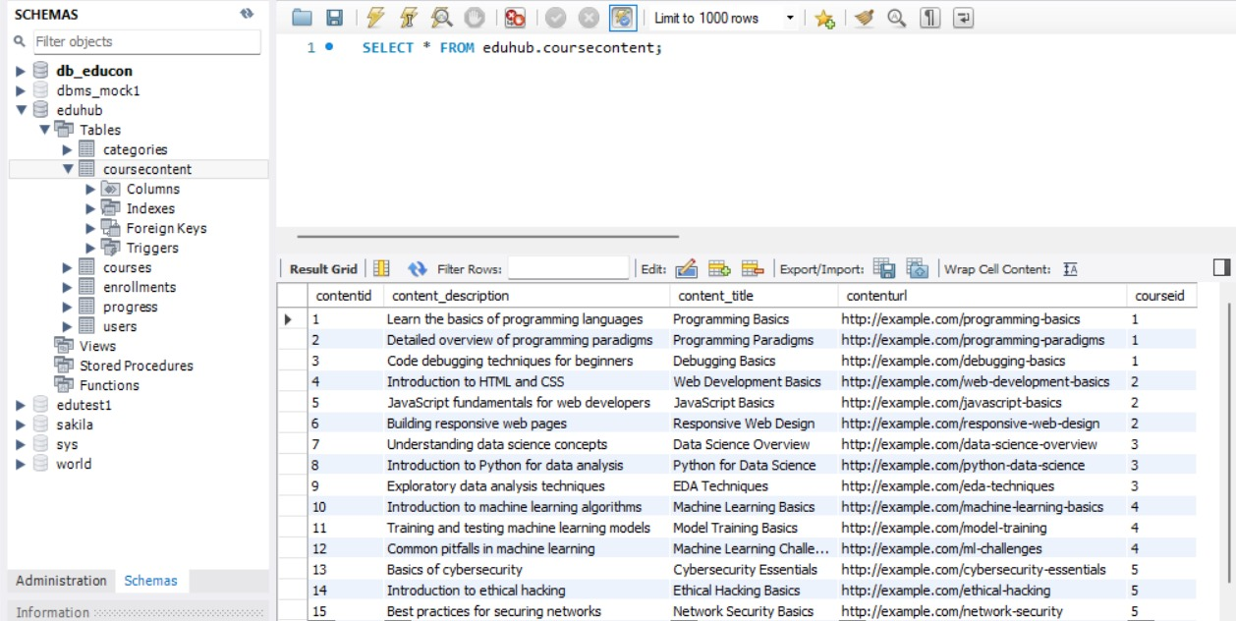
The coursecontent table in the eduhub database stores course-related details, including content descriptions, titles, URLs, and their respective course associations.

Slide 14
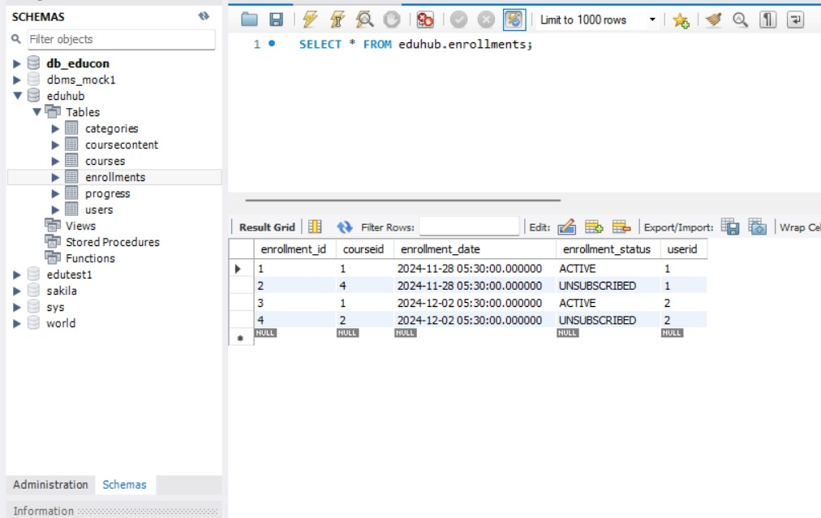
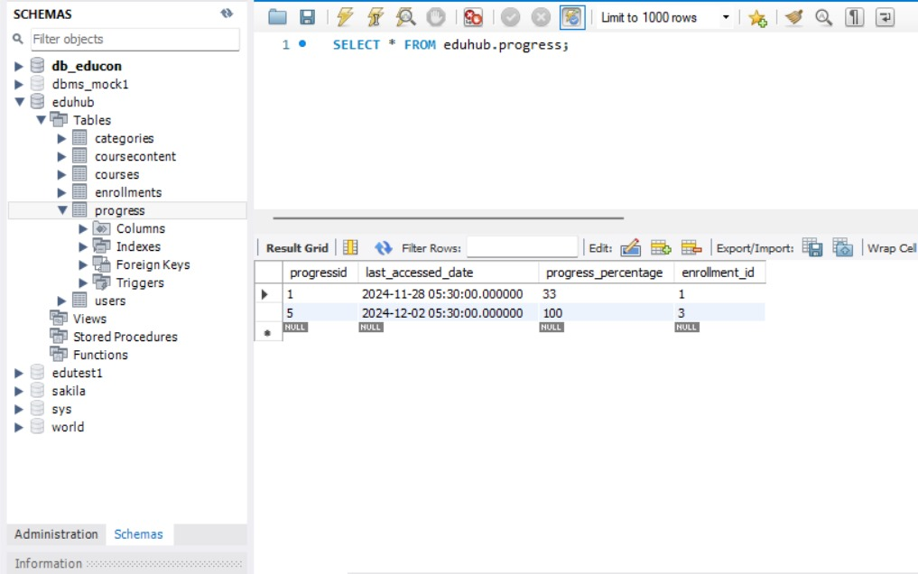
Courses Enrolled Database
Course Progress Database

Slide 15
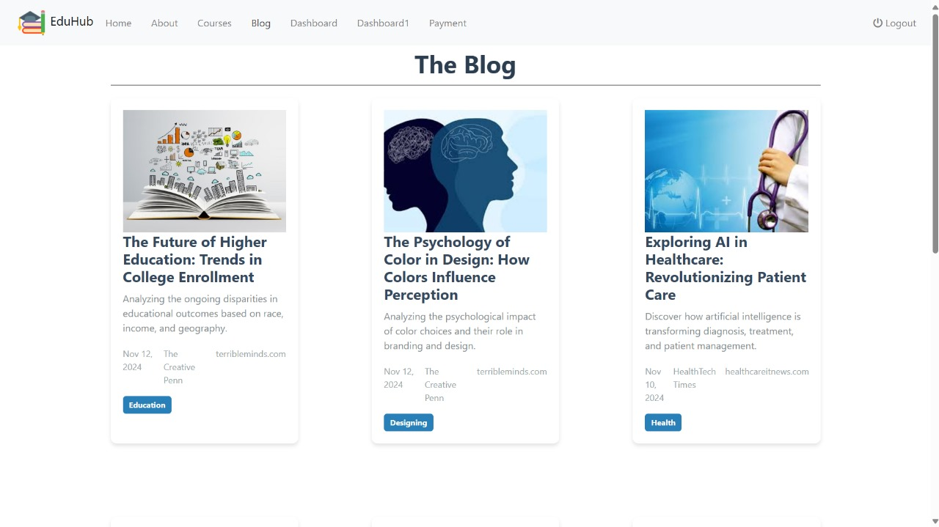

Slide 16
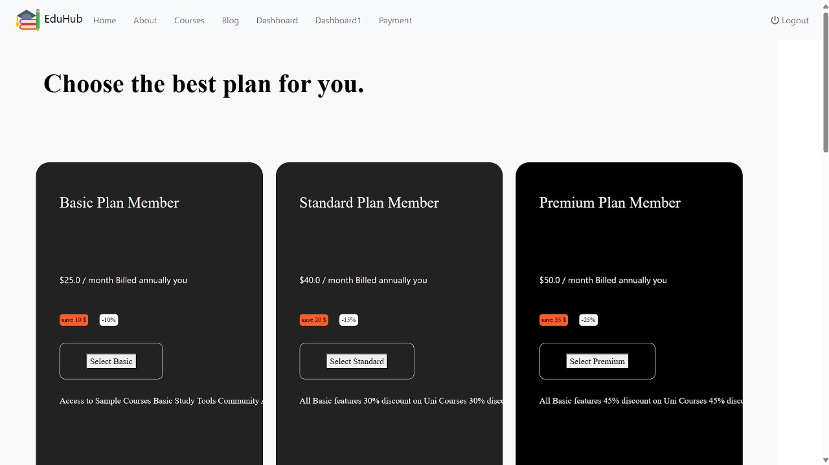
MILESTONE 3 – PAYMENT MANAGEMENT

Slide 17
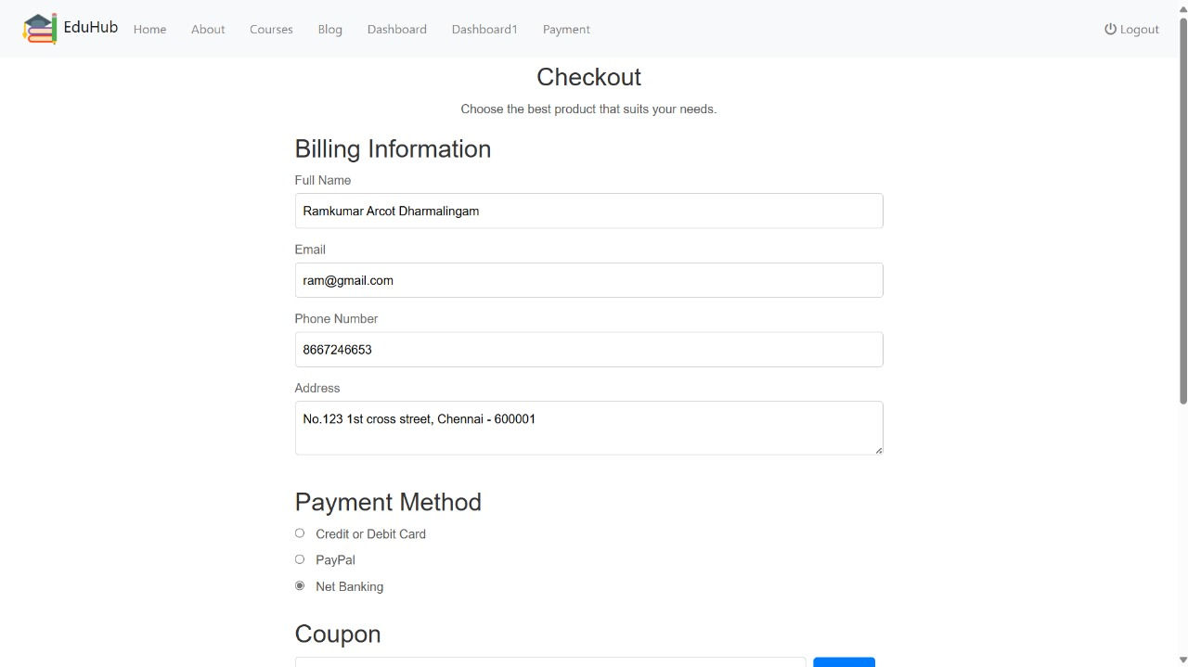
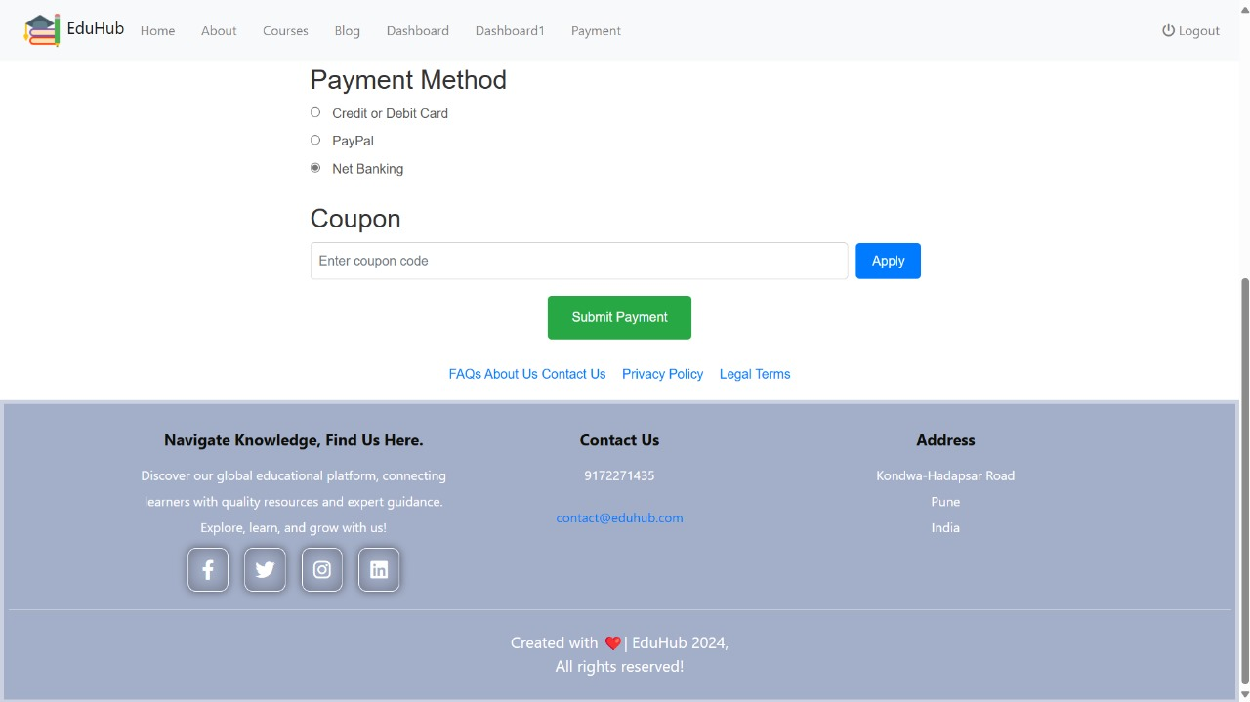

Slide 18
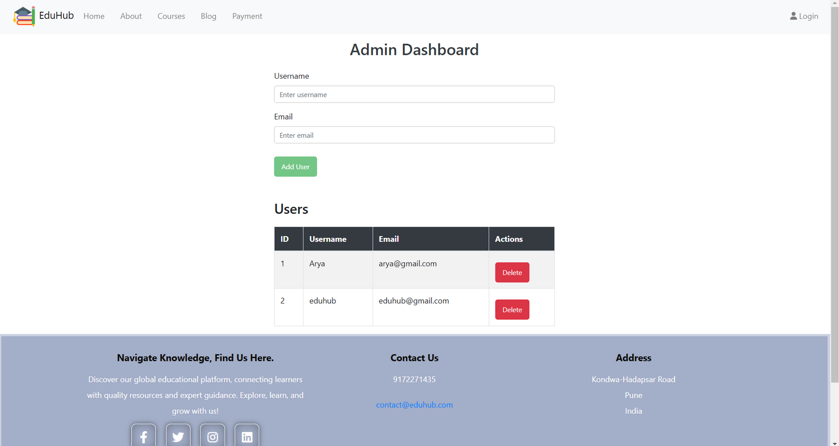
ADMIN DASHBOARD

Slide 19


FUTURE SCOPE
AI-Generated Blogs and Updates: Automated content generation for blogs and regular updates on educational trends.
Advanced Analytics Dashboard: AI-powered insights and recommendations for tracking student progress effectively.
Mobile Application: Cross-platform app for seamless access to features, notifications, and updates.
Chatbot Integration: Real-time AI chatbot for student and parent assistance.
Video Conferencing: Direct online consultations with consultants through integrated video calling.

Slide 20
CONCLUSION
COMPREHENSIVE LEARNING PLATFORM: EDUHUB SUCCESSFULLY INTEGRATES COURSE CONTENT, USER MANAGEMENT, AND PROGRESS TRACKING INTO A SINGLE, EFFICIENT SYSTEM.
SECURE AND USER-FRIENDLY: WITH ROBUST AUTHENTICATION AND INTUITIVE DESIGN, THE PLATFORM ENSURES A SAFE AND SEAMLESS USER EXPERIENCE.
FUTURE-READY DESIGN: THE MODULAR STRUCTURE ALLOWS EASY SCALABILITY, SUPPORTING INNOVATIVE FEATURES LIKE AI-GENERATED BLOGS AND DAILY UPDATES.
ACCESSIBLE EDUCATION: EDUHUB EMPOWERS LEARNERS BY PROVIDING AN ENGAGING, CENTRALIZED PLATFORM FOR QUALITY EDUCATION.

Slide 21

THANK YOU

